Slide 1



Data Structure
&
Algorithm
Class VIII
lab 12

Slide 2


Queue
an ordered collection of items

Slide 3
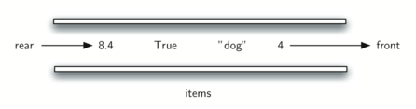
Positions
addition of new items happens at one end, called the “rear” and the removal of existing items occurs at the other end, commonly called the “front”

Slide 4
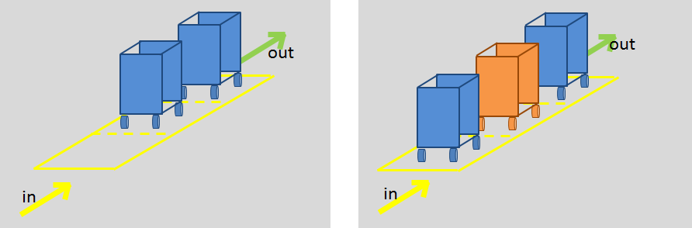
FIFO (First in First Out)
This ordering principle is sometimes called FIFO

Slide 5
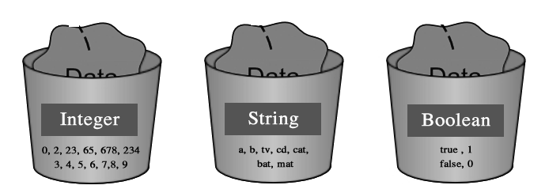
Data Type
Queue()
enqueue(item)
dequeue()
isEmpty()
size()

Slide 6
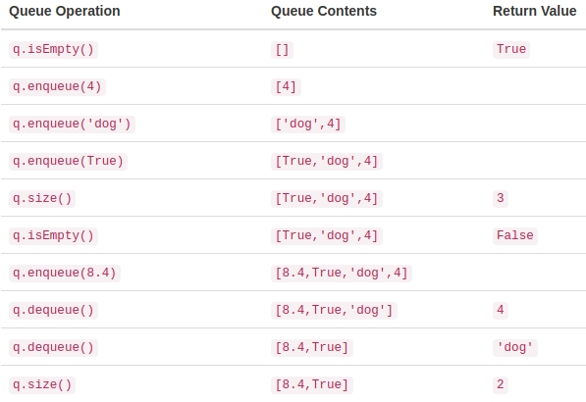
Output

Slide 7


